Slide 1
Lab 6 Iterative Control in C
By Sumaiyah Zahid

Slide 2
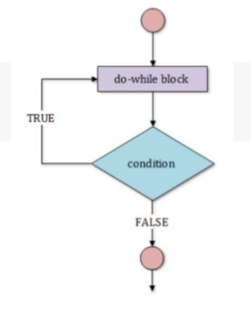
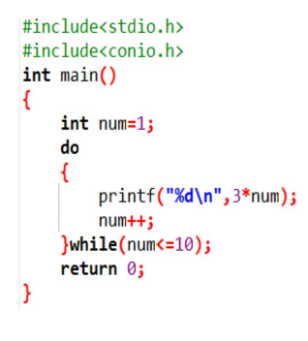
Do While Loop

Slide 3
Lab Activity
Write a program that asks user to input the starting number and ending number of the range. The program should display the number of multiples of 5 in between that range.
Write a program that asks user an integer and keeps adding it until user enters 0.

Slide 4
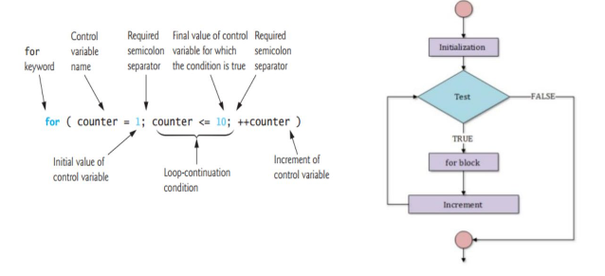
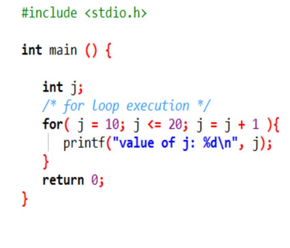
For Loop

Slide 5


Slide 6
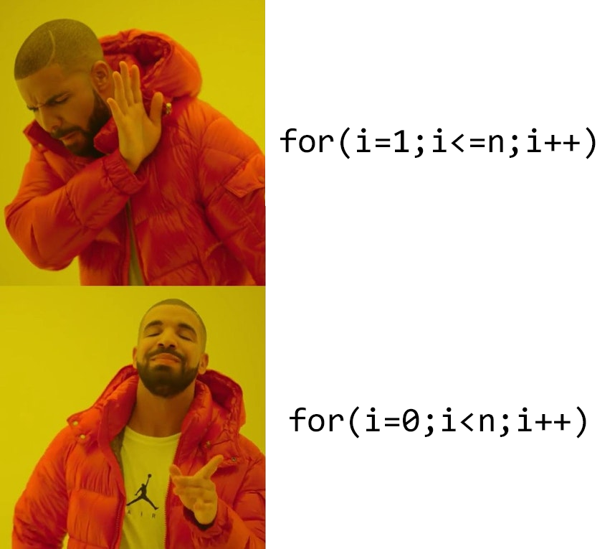

Slide 7
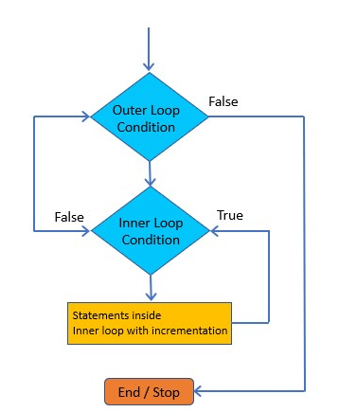
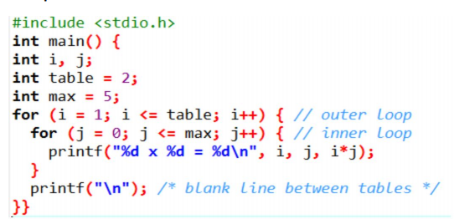
Nested Loops

Slide 8
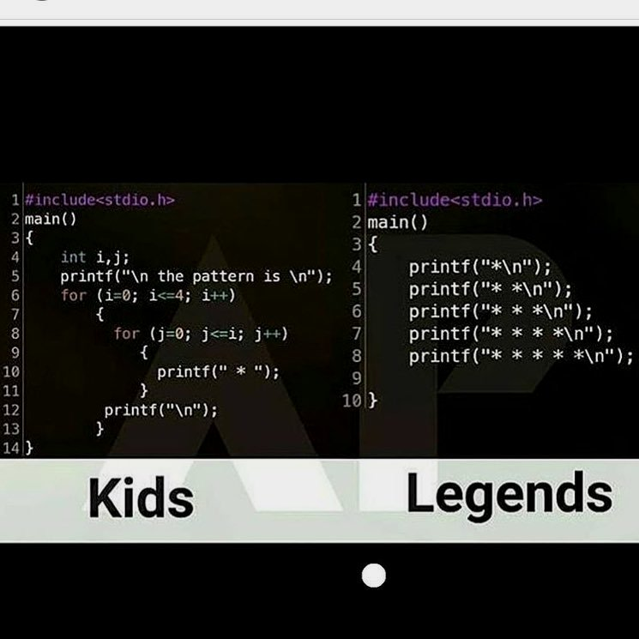

Slide 9
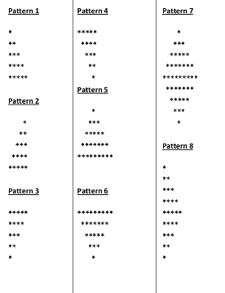
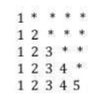
Lab Activity
3-11 Print all these pattern using nested loops

Slide 10


Slide 11
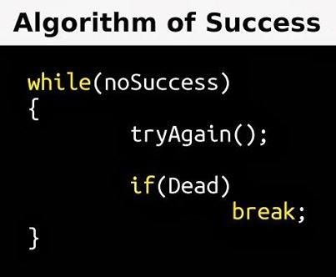
Break Vs Continue

Slide 12
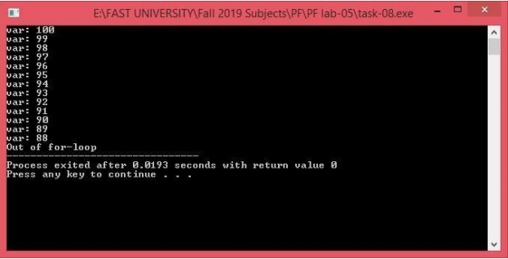
Lab Activity
12 Write a program that uses break statement when value of variable becomes 88 and print the statement that “Out of for loop”. Out should be like the displayed below.

